Slide 1
INTRODUCTION TO PYTHON
Sourav Karmakar
souravkarmakar29@gmail.com

Slide 2
What is Python?
Python is a High Level, Interpreted, General Purpose Programming Language used for various tasks like:
Scripting and Automation
Backend Web Development (server side tasks)
Machine Learning and Data Science
Data Engineering
Simulations
Etc.
Python was developed by a Dutch programmer Guido Van Rossum and was first released in the year 1991.
Python 2.0 was released in the year 2000 with more features. However Python-2 is discontinued after version 2.7.18 in the year 2020.
Python 3.0 was released in the year 2008. Python-3 codes are not compatible with Python-2. Currently the latest stable version is Python 3.9.
In our course we shall follow Python 3.x. (Usually Python 3.6+)

Slide 3
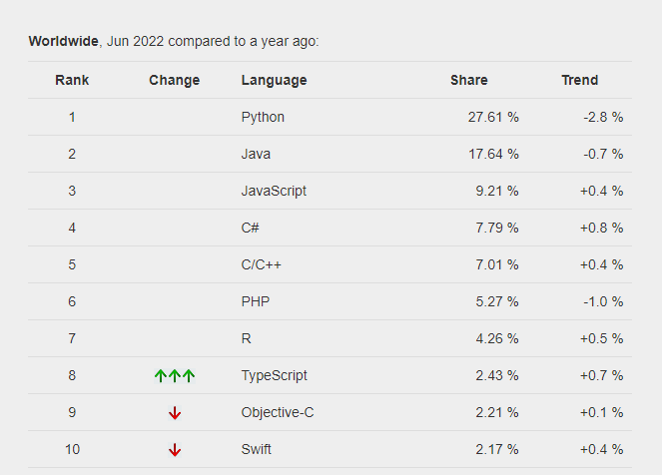
Why should we learn Python?
Python is the most popular language in the world
The PYPL : PopularitY of Programming Language Index is created by analyzing how often language tutorials are searched on Google.
The more a language tutorial is searched, the more popular the language is assumed to be. It is a leading indicator. The raw data comes from Google Trends.
Source: https://pypl.github.io/PYPL.html

Slide 4
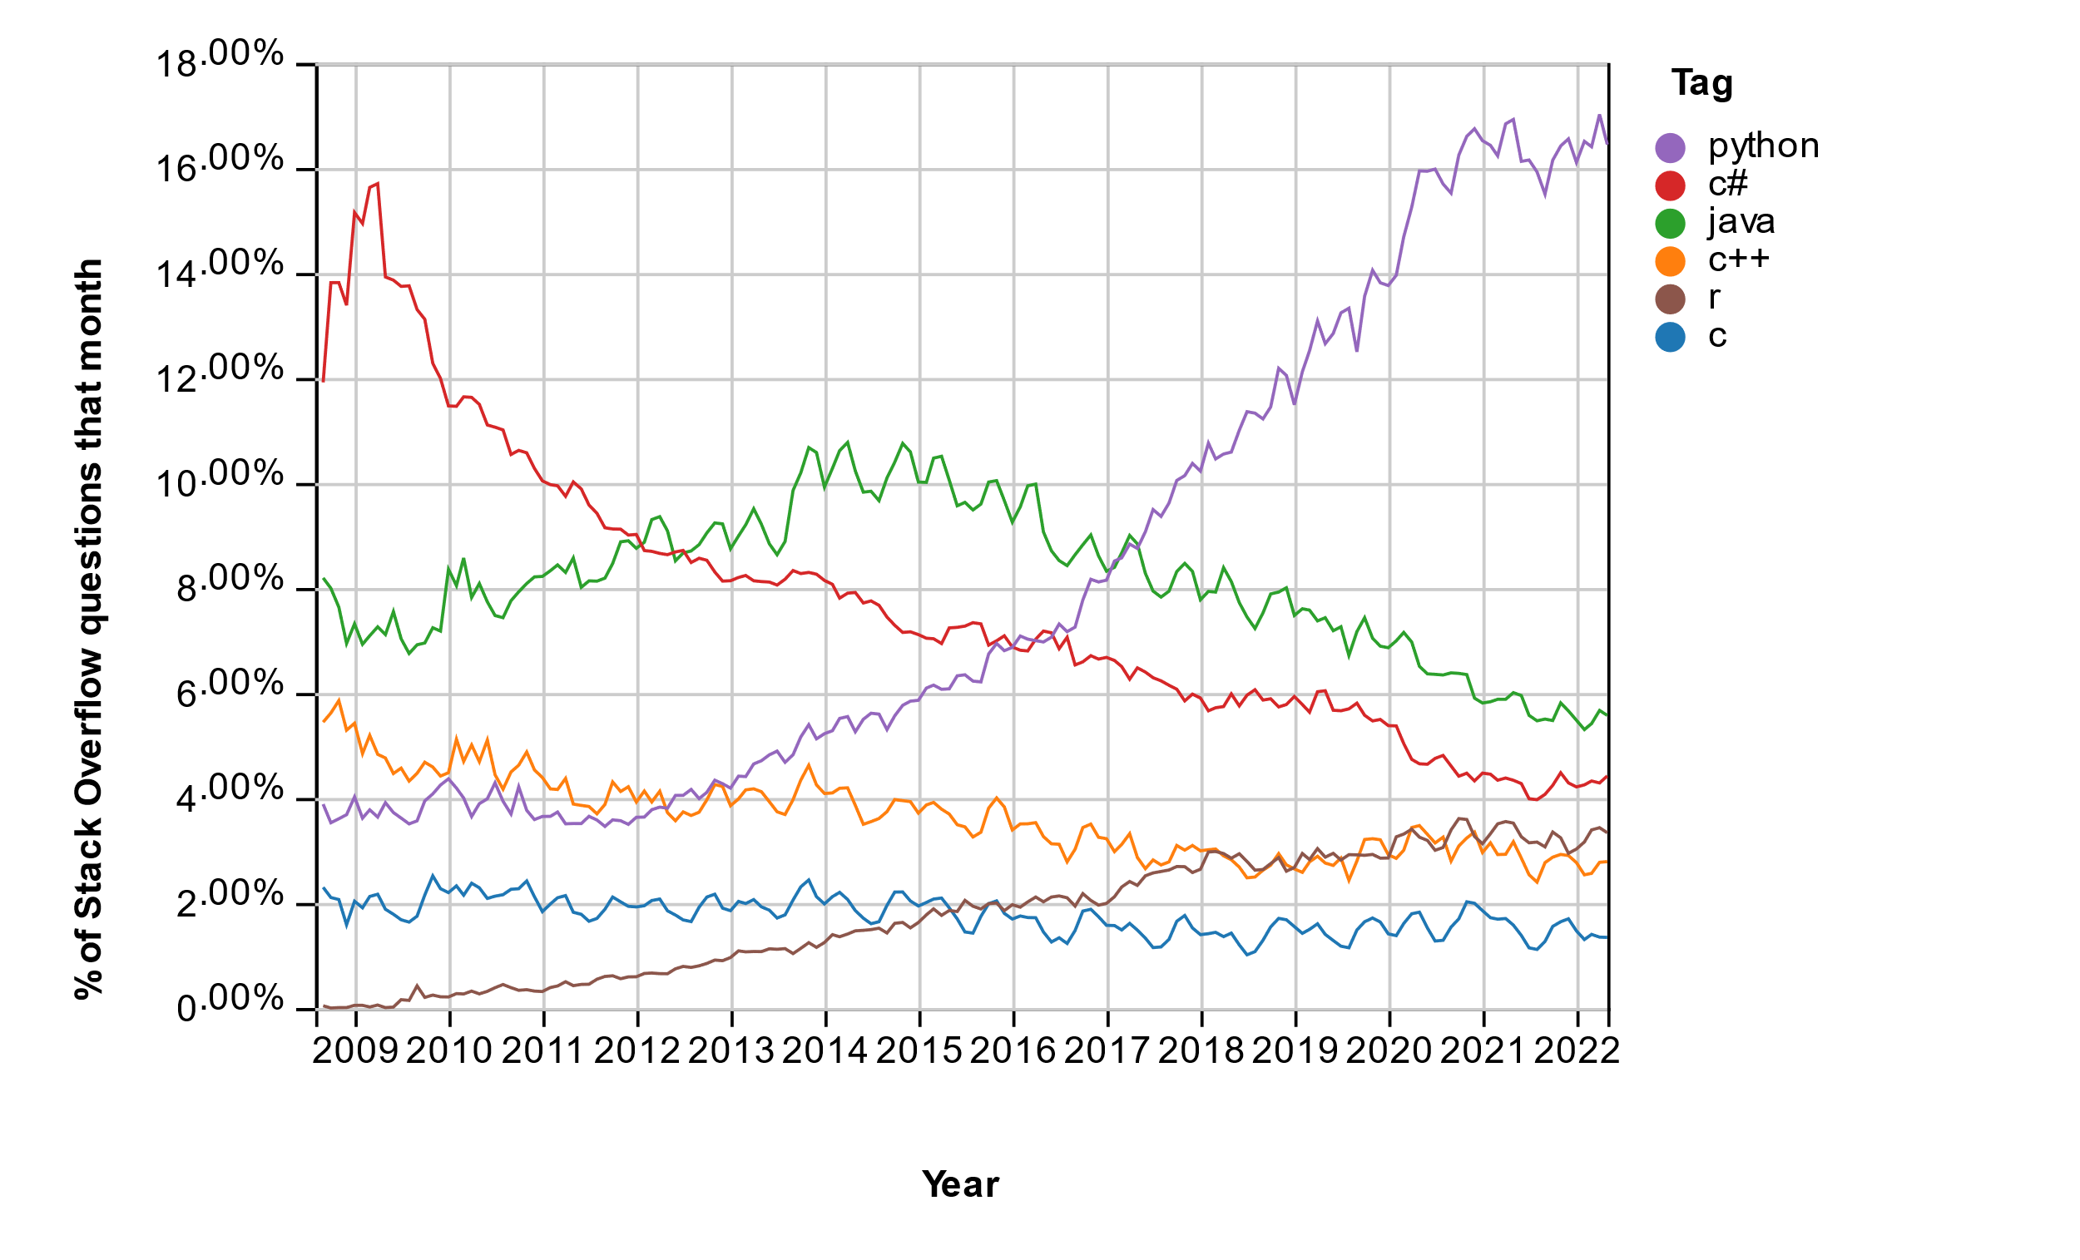
Why should we learn Python?
Python is the fastest growing programming language.
This trend shows how often questions of different languages have been asked in stackoverflow.com website. In Stackoverflow people ask questions on programming and developers from all over the world answer the question.
We found that Python is most asked programming language in the website. Which means Python is the fastest growing Programming language.
Python has increasing trend since 2010 and now a days it is the most popular language.

Slide 5
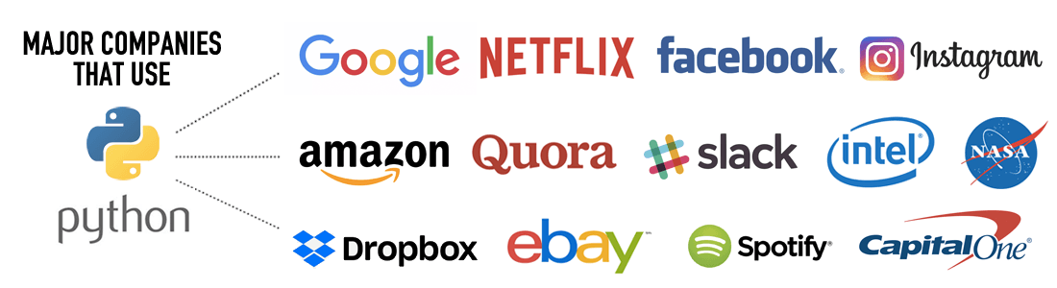
Why should we learn Python?
There is widespread use of python in different industry and academia.
This widespread usage of python ensures a promising career opportunity for a good python developer.

Slide 6
Why should we learn Python?
Python is very beginner friendly. Python syntaxes are easy to Read, Write and Debug. Hence for many programmers Python is the first preference.
Python has very enthusiastic and supportive user base and community. That means, if one person is stuck somewhere while coding in python, he/she can readily take help from online community forums like stackoverflow.
Python is language of choice for Machine Learning, Deep Learning and Data Science programmers for availability of useful and sophisticated open-source libraries, which make coding simpler in python.
Few of the Python libraries suitable for Data Science work are:
NumPy
Pandas
Scikit Learn
Matplotlib
Seaborn
Tensorflow
Pytorch
Etc.

Slide 7
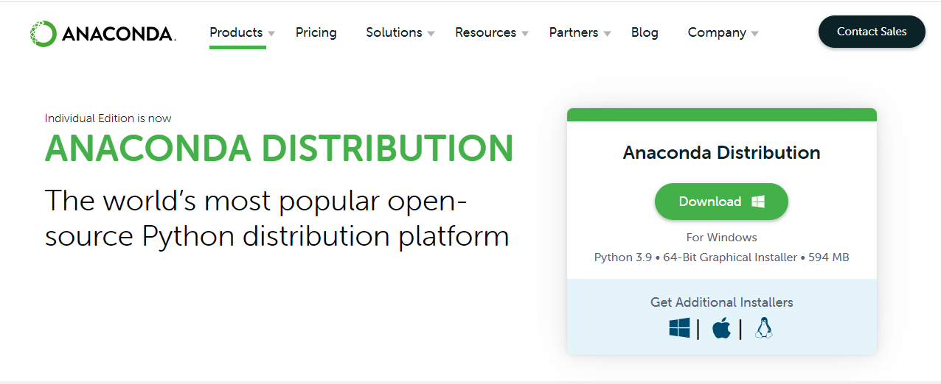
How to install Python?
We shall use Anaconda Distribution throughout our course.
The reason of using Anaconda Distribution is it comes with Jupyter Notebook and a bunch of preinstalled libraries necessary for Data Science Job.
We shall go to the website: https://www.anaconda.com/products/distribution and will download the installer.

Slide 8
Thank You

